Slide 1
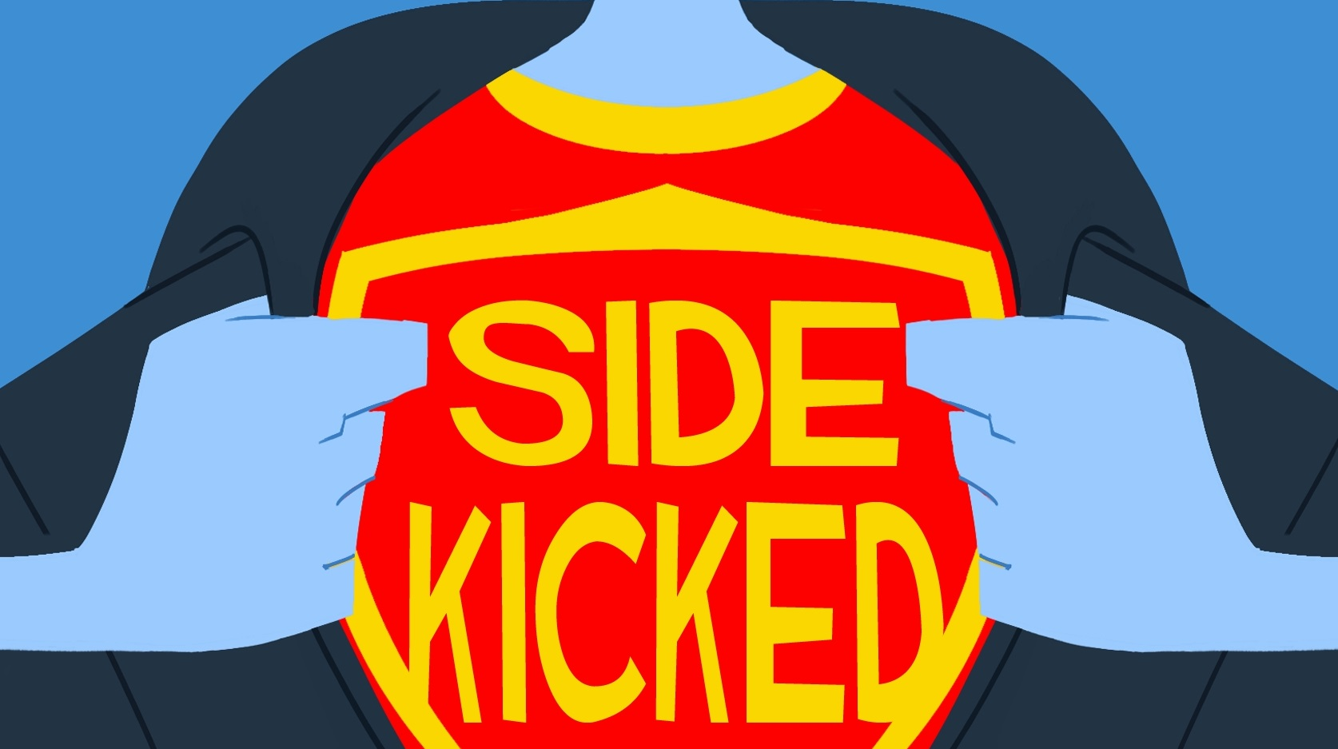
50 REASONS TO READ THE BOOK

Slide 2
50. It is the only coming-of-age middle-grade serio-comic superhero novel published in June of 2013. Actually I don't know if that's true, but let's just assume it is.

Slide 3
49. It is high in fiber and contains no MSG.

Slide 4
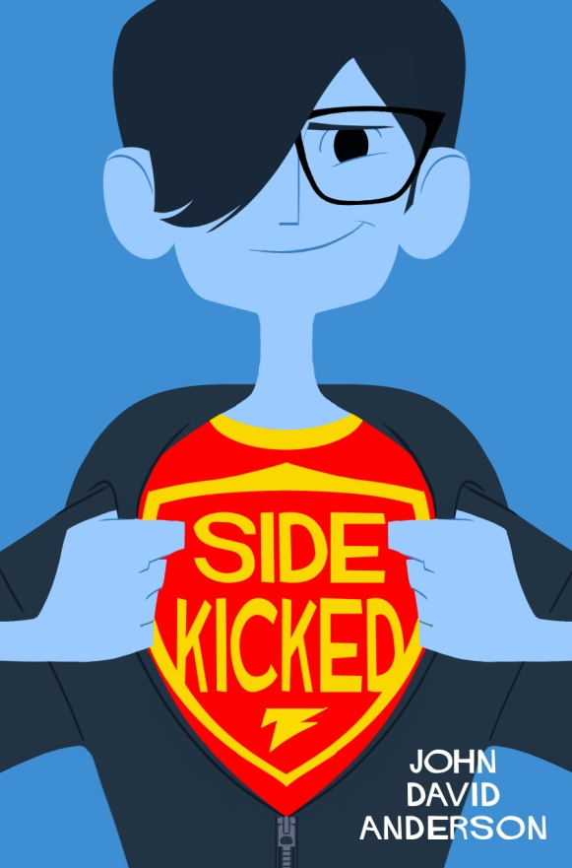
48. It has a really awesome cover.

Slide 5
47. Three words:

Slide 6
47. Three words: multiple

Slide 7
47. Three words: multiple gratuitous

Slide 8
47. Three words: multiple gratuitous explosions

Slide 9
46. It contains exactly one well-placed instance of flatulence-related humor.

Slide 10
45. Strong female characters.

Slide 11
45. Strong female characters. Like...pick up and throw cars strong.

Slide 12
44. How many novels do you read where the main character has to deliberate over the ever-blurring line separating "good" from "evil" while simultaneously debating the merits of middle-school health class as he's being dangled over a pool of hydrochloric acid by a man in a bee costume? I'm going to safely say less than ten.

Slide 13
43. The book contains no advertisements for army men, x-ray glasses, or Sea Monkeys.

Slide 14
43. The book contains no advertisements for army men, x-ray glasses, or Sea Monkeys. Mmmm...delicious Sea Monkeys...

Slide 15
42. It will give you something to do in between franchise reboots and Iron Man sequels.

Slide 16
41. Because we've all had heroes who've failed us.

Slide 17
40. And heroes who haven't.

Slide 18
39. Comes in convenient e-book format. Also comes in less convenient but decidedly more three-dimensional paper book format. (Note: 3D glasses not required.)

Slide 19
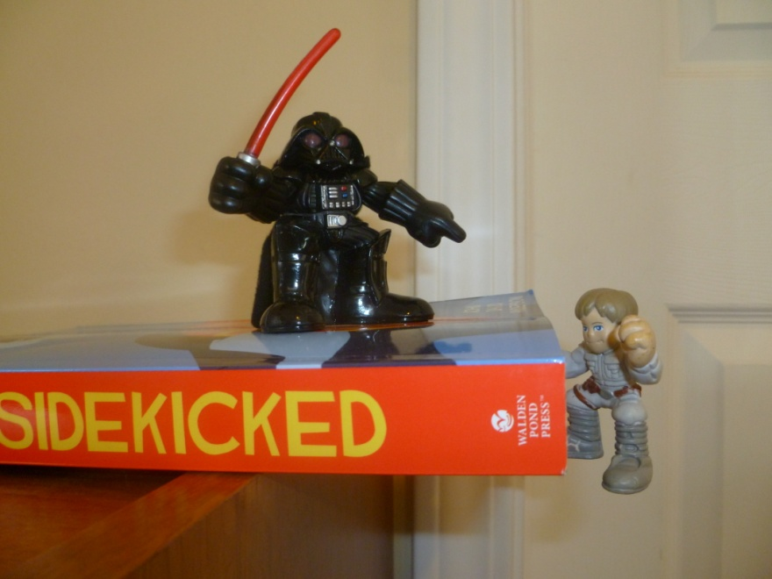
38. Can be used to help stage your favorite Star Wars battle scenes.

Slide 20
37. It's about 370 pages, which scientists have confirmed is the ideal page count for maximizing reader investment and structural plot integrity relative to modern attention spans and the need to preserve rain forests.

Slide 21
36. I've been told it's a good book for reluctant readers, which is another name for "boys who think every book would be better with ninjas in it." There are no ninjas in Sidekicked, but there are katanas, which are the next best thing. Side note: Little Women could use some ninjas.

Slide 22
35. A city is rigged with explosives, a superhero is sapped of his powers, and a villain quivers with glee...and that's all just in the PROLOGUE!

Slide 23
34. It's ha-ha funny. Which is the best kind of funny, really.

Slide 24
33. The main character has extraordinary senses, which means he is capable of seeing the fist of evil REALLY CLEARLY before it smashes him in the face.

Slide 25
32. My eight-year-old son started reading it and says most of the words are spelled right. He thinks.

Slide 26
31. It contains the prerequisite awkward middle-school romance angle but minimal smooching (it is NOT a kissing book, for all you Princess Bride fans out there).

Slide 27
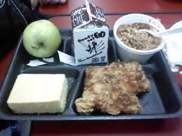
30. It's rated PG for cartoon violence, intense action sequences, and vivid descriptions of school lunches.

Slide 28
29. Ursula K. Le Guin said, "The unread story is not a story; it is little black marks on wood pulp. The reader, reading it, makes it live..." So, reading makes you, like, the Dr. Frankenstein of the book world. Awesome.

Slide 29
28. Superhero sidekicks don't get enough love. I'm looking at you Krypto the Superdog. And you too, Aqualad. Seriously? Aqualad!!???

Slide 30
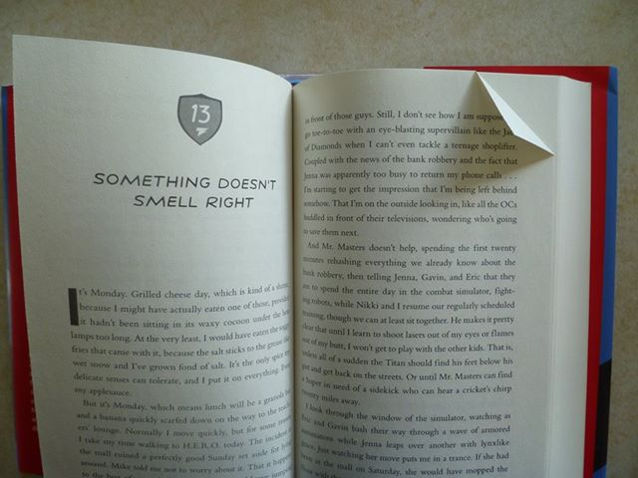
27. Each copy of Sidekicked comes with approximately 190 foldable, reversible, corner-tip bookmarks so that you will never forget what page you're on again!

Slide 31
26. It contains awesome vocabulary words that every young reader should know. Like "vixen". And "cyclotrimethylene trinitramine".

Slide 32
25. It should appeal to fans of superheroes, satire, coming of age novels, books with red on their covers, and/or fun.

Slide 33
24. Margaret Peterson Haddix, bestselling author of way more books than me, called it funny and suspenseful.

Slide 34
23. It solves the age-old conundrum of whether vampires or werewolves make better boyfriend material (page 125).

Slide 35
22. In an act of pure rebellion against the author's third grade English class and all its oppressive rules, the novel contains several sentences that start with a coordinating conjunction. But most of them don't. Fight the power.

Slide 36
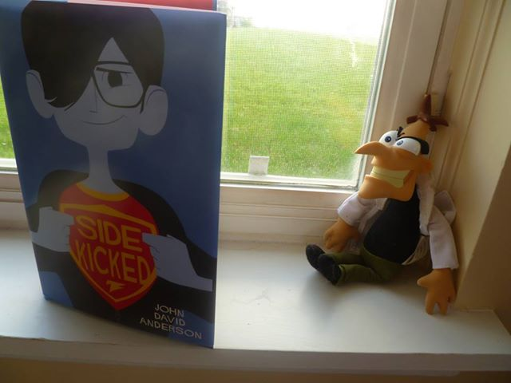
21. Budding evil geniuses and criminal masterminds in training may find inspiration for their next nefarious plot somewhere in its pages.

Slide 37
20. Hours of commercial-free entertainment. Some imagination required.

Slide 38
19. Reading Sidekicked can grant you SUPER POWERS! Disclaimer: Super powers are purely pretend and should not be mistaken for actual ability. Power is commensurate with reader's imagination. You should not try to fly while reading Sidekicked. Do not assume you are invisible as a result of reading Sidekicked. You can try to walk through walls, but make sure your friends are around to see it. Everyone needs a good laugh every now and then.

Slide 39
18. It's told from the point of view of Andrew Macon Bean. Where else can you find a protagonist named after a legume, a city in Georgia, and the first president of the United States ever to be impeached?

Slide 40
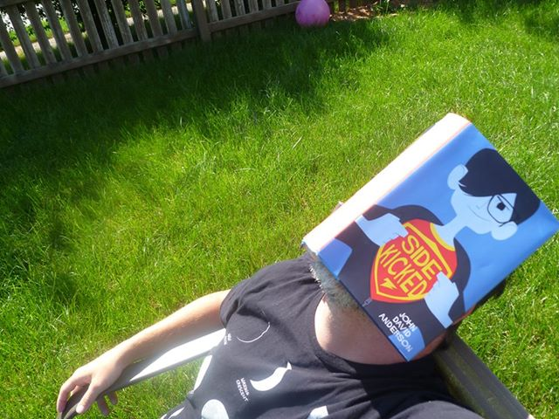
17. Allows you to disguise yourself as "Person Totally Engrossed in Book" when really you are "Person Secretly Taking Afternoon Nap".

Slide 41
16. Also provides a handy defensive shield against harmful UV rays (See #17). Take that sun!

Slide 42
15. Teaches important life lessons, such as be patient, don't panic, and don't leave your utility belt in your locker.

Slide 43
14. Reading it provides twelve billion points for the Justicia Community Library Summer Reading Program, which can then be traded in for pencils and small containers of viscous iridescent slime the color of radioactive snot.

Slide 44
13. Makes for an excellent beach read. (Beach not included.)

Slide 45
12. IT CONTAINS A WICKED LIGHTSABER DUEL! Okay. That's not really true. But it does contain an awesome scene where the main character WISHES he had a lightsaber. I wish I had a lightsaber...

Slide 46
11. Because "there is no friend as loyal as a book." - Ernest Hemingway And there's probably room on your shelf for more friends.

Slide 47
10. Page 314 is pretty funny. And the incident around page 130. Oh, and then there's the scene that starts at the bottom of page 171...that's a personal favorite. And there's that one moment where, you know, that one guy does that thing...you know...that thing? Oh heck. Just go read it yourself.

Slide 48
9. Because, as every kid knows, if you don't read a book, all the characters in that particular book DIE from NEGLECT and LACK OF PURPOSE. NOT reading a book is like committing the literary equivalent of involuntary manslaughter. You don't want that on your conscience. So reason #9 is like reason #29, except with extra guilt.

Slide 49
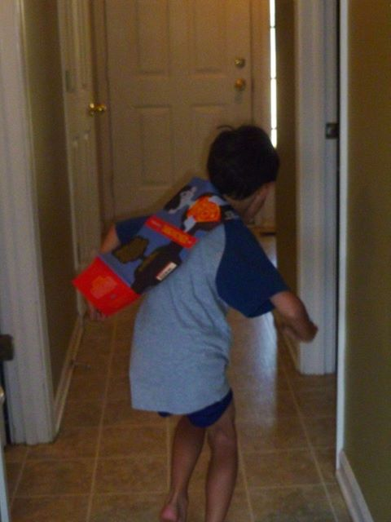
8. The dust jacket makes a nice impromptu cape for budding superheroes.

Slide 50
7. Because you may be depressed from binging on too many dystopian YA novels and looking for something a little more upbeat?

Slide 51
6. My eight-year-old, dust-jacket-cape-wearing son says "because it's funny AND fighty." And who doesn't like fighty?

Slide 52
5. It has themes...

Slide 53
5. It has themes...put there specifically for English teachers to bug their students about.

Slide 54
4. It contains many of our most basic narrative conflicts: Man against Man. Man against Himself. Man against Society. Man against Blunt Object. Man against School Lunch. Man against Middle-School Popularity Contest, and Man against Moral Absolutism. It does not contain Man against Shark, however. Saving that for a sequel.

Slide 55
3. Because I already had you at reason number 46.

Slide 56
2. Because if enough people read it, somebody will turn it into a movie. And then we can all fight over who should play what role and whether or not the director has a conflict of interests and why the Andrew Macon Bean action figure doesn't come with Kung-Fu Grip and whatnot. I wish I had Kung-Fu Grip.

Slide 57
1. Because I honestly think you'll enjoy it. I hope you do.

Slide 58
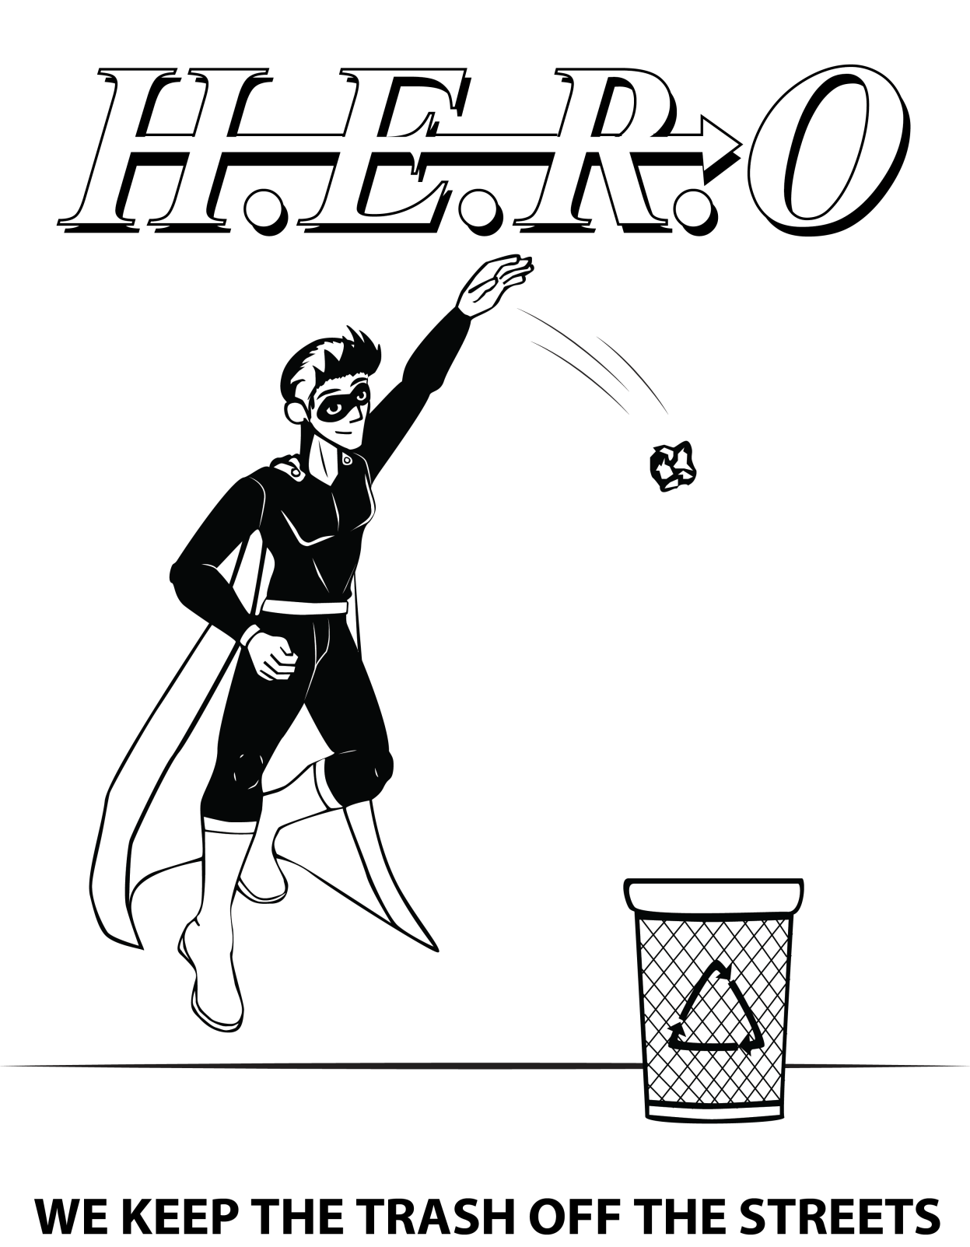

Slide 59
For more information, visit the author at www.johndavidandersonauthor.org

